Slide 1

MALIGNANT COMMENTS CLASSIFICATION
Submitted by:
Kunal chand
Internship-19

Slide 2
INTRODUCTION
Business Problem Framing
There has been a remarkable increase in the cases of cyber bullying and trolls on various social media platforms. Many celebrities and influences are facing backlashes from people and have to come across hateful and offensive comments. This can take a toll on anyone and affect them mentally leading to depression, mental illness, self-hatred, and suicidal thoughts.
Our goal is to build a prototype of online hate and abuse comment classifier which can be used to classify hate and offensive comments so that they can be controlled and restricted from spreading hatred and cyber bullying.

Slide 3
The 7 Key Steps To Build Your Machine Learning Model
Step 1: Collect Data.
Step 2: Prepare the data.
Step 3: Choose the model.
Step 4 Train your machine model.
Step 5: Evaluation.
Step 6: Parameter Tuning.
Step 7: Prediction or Inference.

Slide 4
Conceptual Background of the Domain Problem
The conceptual background of the problem depends on the language and words which make any comment toxic or neutral, our main motto is to find those words which are highly malignant.
Review of Literature
Data exploration is the first step in data analysis and typically involves summarizing the main characteristics of a data set, including its size, accuracy, initial patterns in the data, and other attributes. It is commonly conducted by data analysts using visual analytics tools, but it can also be done in more advanced statistical software, Python. Before it can analyze data collected by multiple data sources and stored in data warehouses, an organization must know how many cases are in a data set, what variables are included, how many missing values there are, and what general hypotheses the data is likely to support. An initial exploration of the data set can help answer these questions by familiarizing analysts with the data with which they are working. We divided the data 8:2 for Training and Testing purposes respectively.

Slide 5
Motivation for the Problem Undertaken
Every problem of Machine learning gives us chance to enhance and develop problem-solving skills. These Problems do’s the same.
When this real-life problem of predicting whether the comments to anybody is legal or not which kind of words are used and how much they are toxic to someone, whether to rely on old data or new data words are words they are accepted globally important and with help of A. I technology we make a completely new model of detection. As Data scientists it is our role to help and understand the market better with newer data, for constructing real-life helpful models for companies.
In this project, we have a dataset of comments and their categories of how lethal they are, for that, we have to analyze those features which make comments toxic and help companies to build the detection models for filtration and stopping such comments for plotting.

Slide 6
Data Sources and their formats
Data Set Description
The data set contains the training set, which has approximately 1,59,000 samples, and the test set which contains nearly 1,53,000 samples. All the data samples contain 8 fields which include ‘Id’, ‘Comments’, ‘Malignant’, ‘Highly malignant’, ‘Rude’, ‘Threat’, ‘Abuse’ and ‘Loathe’. The label can be either 0 or 1, where 0 denotes a NO while 1 denotes a YES. There are various comments which have multiple labels. The first attribute is a unique ID associated with each comment.
The data set includes:
Malignant: It is the Label column, which includes values 0 and 1, denoting if the comment is malignant or not.
Highly Malignant: It denotes comments that are highly malignant and hurtful.
Rude: It denotes comments that are very rude and offensive.
Threat: It contains an indication of the comments that are giving any threat to someone.
Abuse: It is for abusive comments.
Loathe: It describes the hateful comments and loathing in nature.
ID: It includes unique Ids associated with each comment text given.
Comment text: This column contains the comments extracted from various social media platforms.
This project is more about exploration, feature engineering, and classification that can be done on this data. Since the data set is huge and includes many categories of comments, we can do a good amount of data exploration and derive some interesting features using the comments text column available.

Slide 7
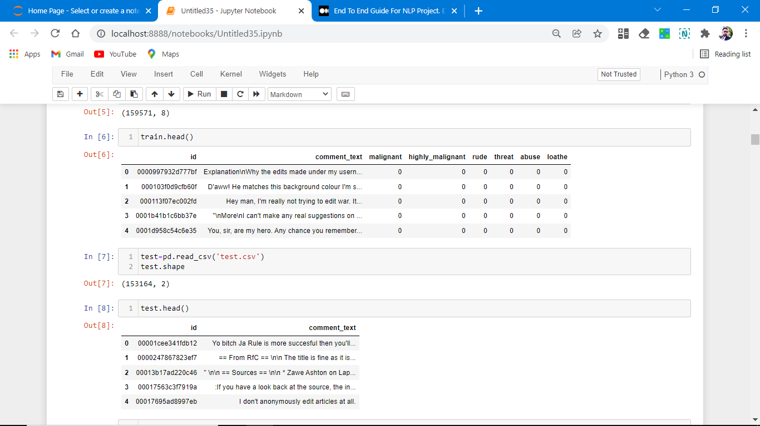
Data set looks as follows.

Slide 8
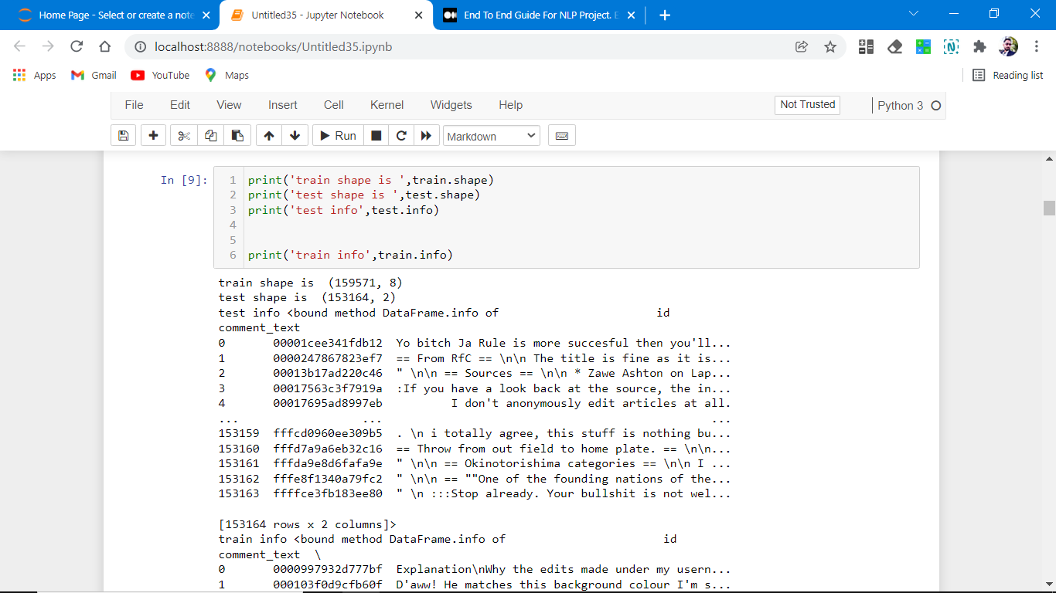
Dataset Information looks as follows-

Slide 9
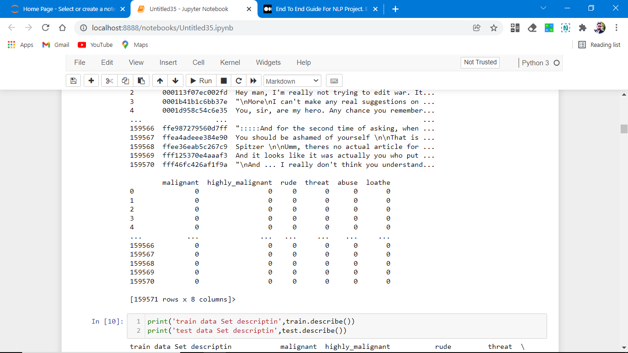
Dataset Information looks as follows-

Slide 10
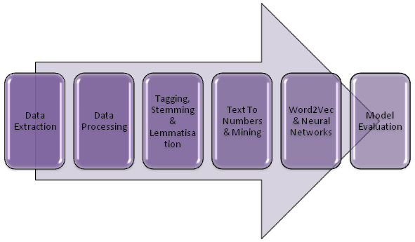
Data Pre-processing Done
This project is based on NLP and we have comments or string data for that we have to first convert comments into words then filter and cleaning of data using several libraries and finally convert them into int data type.

Slide 11
1. Data Extraction: It is the first step of any model. most data is in CSV or excel format and for analyzing the data we use data manipulation tool pandas and NumPy after that data is converted into a data frame for analyzing the data.
2. Data Cleaning: First we clean the data which have no use in prediction like the index column and Id, then we drop the data which has a high no of missing percentages.
3. Stemming And Lemmatisation: The next step is to tag the words via Text Part Of Speech Tagging. Additionally, we are ready to perform Stemming And Lemmatisation In The NLP Data Science Project.

Slide 12
4.Text Mining Algorithms: The text needs to be converted to numbers. Multiple algorithms compute and use the frequency of the words or group them to help us understand their hidden meanings.
5.Word2Vec Algorithm: Now the numerical data needs to be fed into a model so that we can start forecasting it. We can feed our data to a model. Word2Vec algorithm is gaining popularity. Let’s understand how to Predict Text Using
6. Data transformation is the process of changing the format, structure, or values of data; we use a labelled encoder for coding the object data into integer data.
7. Data Reduction: it is the process of finding the most correlated columns, and combining them because the machine does not understand which feature columns impact the most on accuracy.
8. Data discretization converts a large number of data values into smaller once, so that data evaluation and data management becomes very easy, using box plots is makes a clear understanding of the data.
9.Evaluate NLP Model: Now that the NLP algorithm has started to forecast text, the last step is about assessing the accuracy of the model. Learn How To Evaluate The Model Performance

Slide 13
EDA Concluding Remark
As for any basic model building, we have to understand the type of target variable, the data of the target variable is continued or classified.
Data Analysis is always the difficult part, for better understanding different kinds of bar plots, distribution plots are created with the target Column for finding the insights of the dataset we have.
Analytical Modelling always starts with the target variable we have, and in that case, our target variables are text comments first we have to filter them and make data clean then using different analysis tools select the list of toxic words which makes comments malignant, for that, we create some distribution plots with the target variable to understand which feature columns help to learn the model best and which feature columns reduce the accuracy of the model.
And after finding the relation and correlation with the target variable we choose either Regression Model or Classification Model. Here in this problem, our target feature column is classified so we build our Machine Learning model on classification.

Slide 14
Hardware and Software Requirements and Tools Used
1. Python is widely used in scientific and numeric computing:
2. SciPy is a collection of packages for mathematics, science, and engineering.
3. Pandas are data analysis and modeling libraries.
4. Natural Language Toolkit: NLTK is a leading platform for building Python programs to work with human language data. It provides easy-to-use interfaces to over 50 corpora and lexical resources such as WorldNet, along with a suite of text processing libraries for classification, tokenization, stemming, tagging, parsing, and semantic reasoning, wrappers for industrial-strength NLP libraries,
Libraries Used for this Project include –
1. Pandas
2. NumPy
3. Matplotlib
4. Seaborn
5. Scikit Learn
6. Nltk
7. WordNetLemmatizer
8. TF-IDF vactorrization

Slide 15
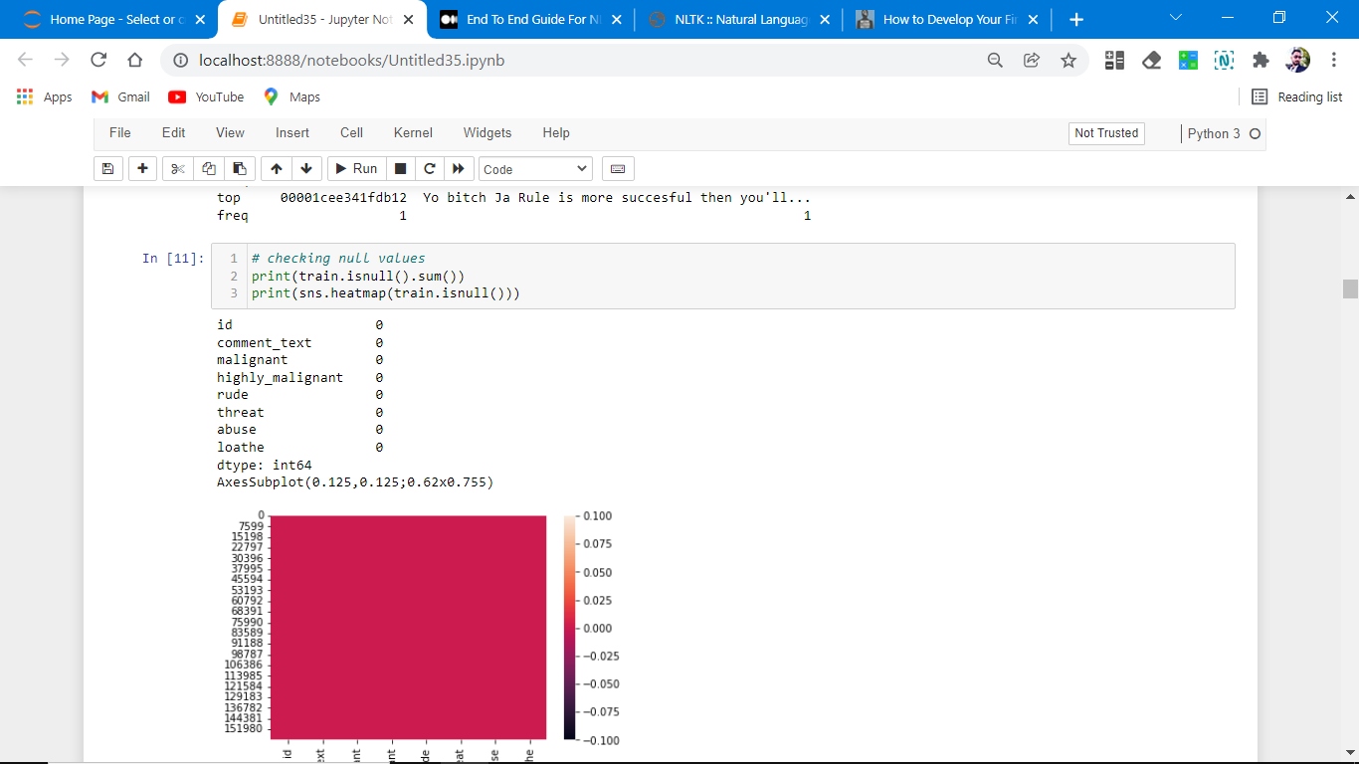
Visualizations
Data visualization is the graphical representation of information and data. By using charts, plots, and graphs data visualization tools provide an accessible way to see and understand trends, outliers, and patterns in data.
In the world of Big Data, data visualization tools and technologies are essential to analyze massive amounts of information and make data-driven decisions.

Slide 16
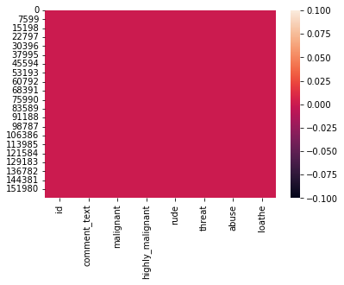
Heat Map Plotting for null values.
As clearly we analyze that no-null values are present.

Slide 17
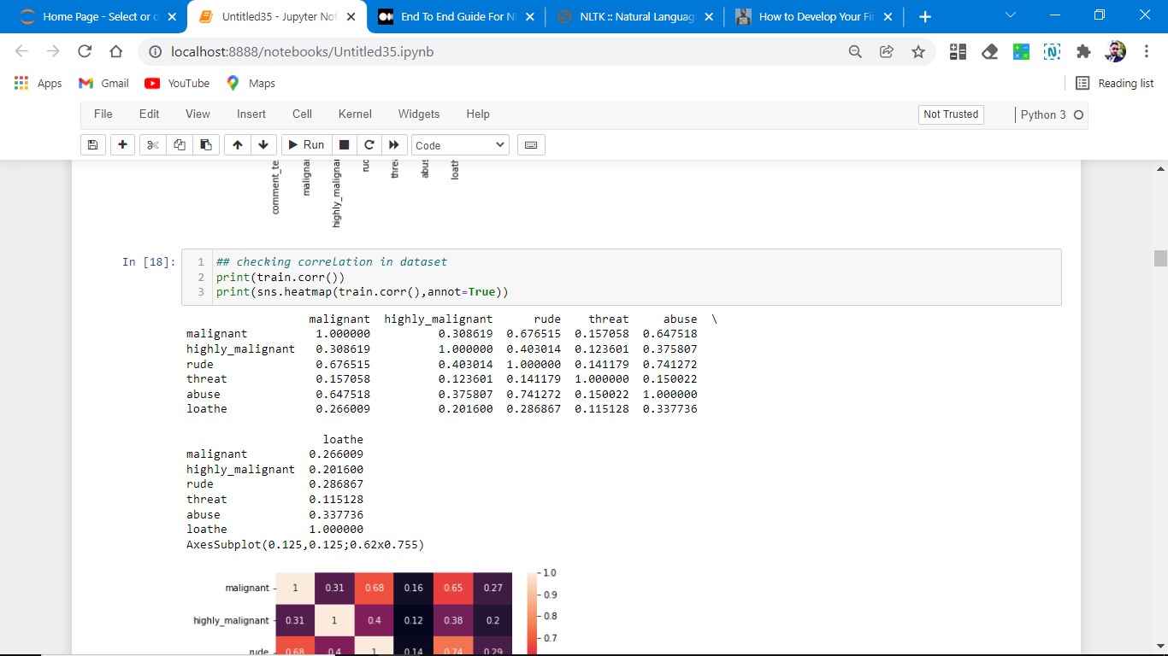
Correlation plotting

Slide 18
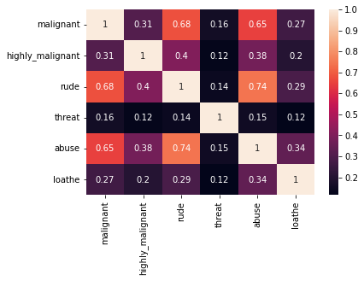
Correlation plotting
No feature columns are negatively co-related with target columns.
Abuse is highly related to malignant.

Slide 19
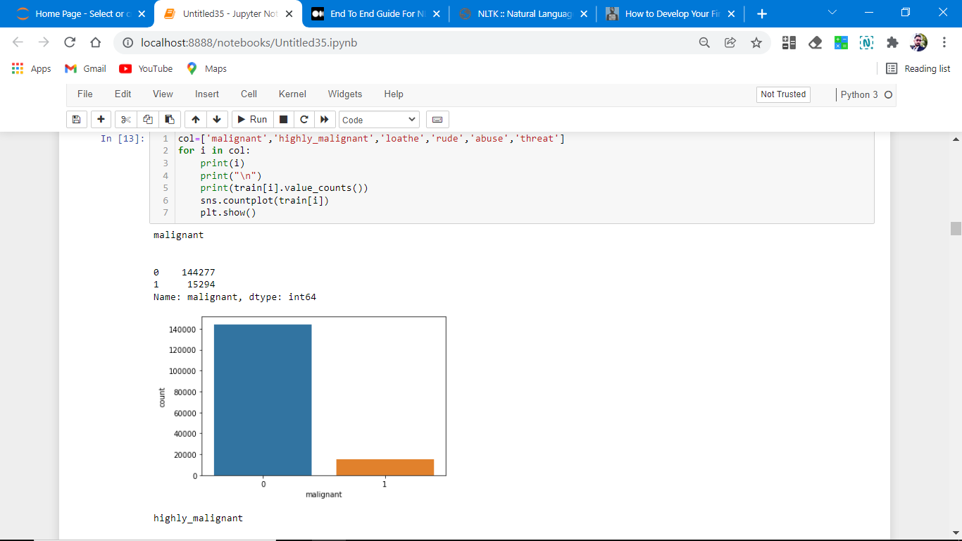
Plotting of different distribution plots.

Slide 20
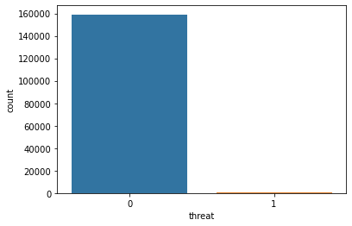
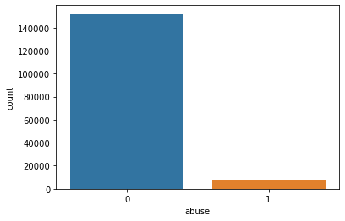
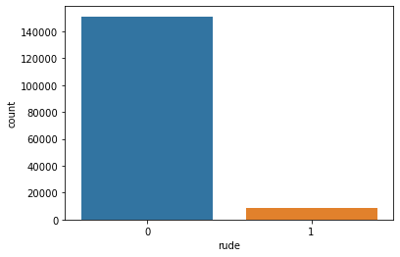


Slide 21
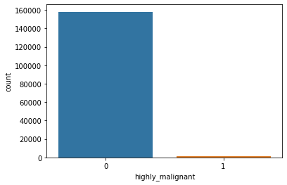
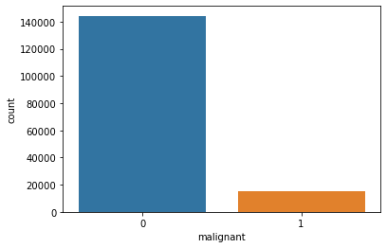
Distribution plotting of different features columns.
And from the above plotting, it is mentioned that the count of normal comments is more than as compared to toxic comments.

Slide 22
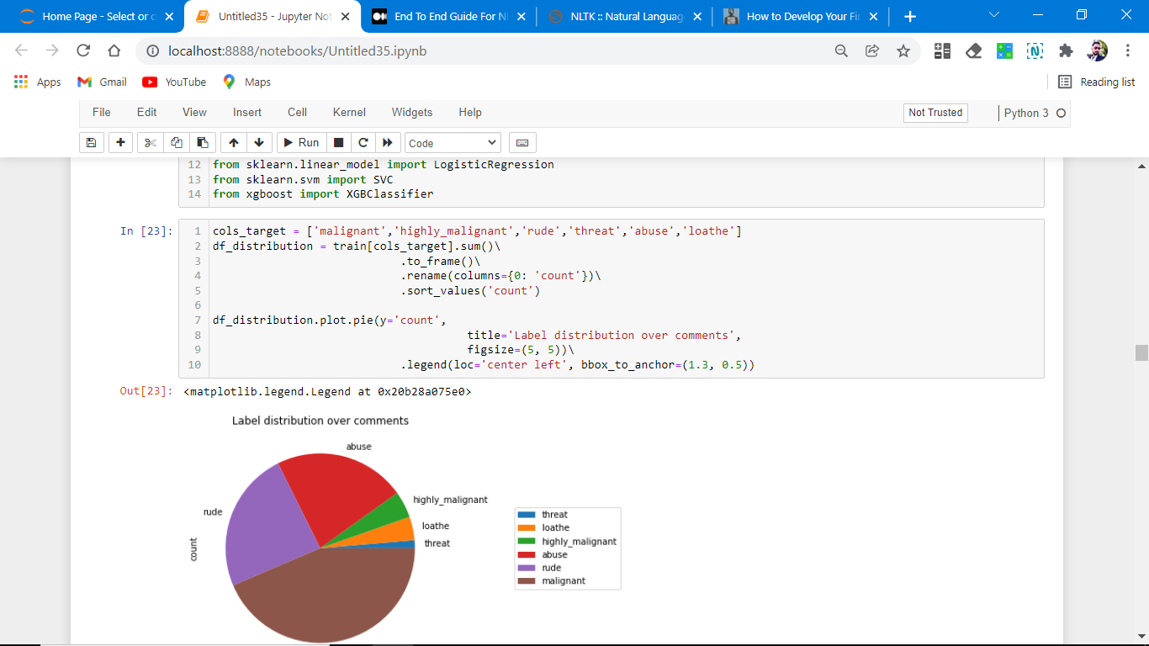
Labels distribution over comments.

Slide 23
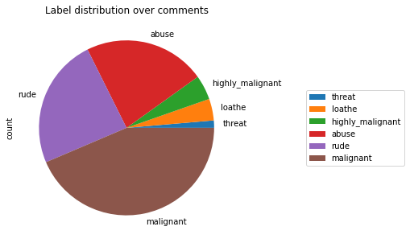
Labels distribution over comments
Plotting of sections of different feature columns and we observe that malignant comments are more as compared to remaining one

Slide 24
Model/s Development and Evaluation
Identification of possible problem-solving approaches (methods)
After analyzing the dataset, I observe that many of the feature columns are int type and coment_text is string type. so first, we have to convert them into an integer so that the machine interprets the data and for that, we use the NLP toolkit for all the features columns.
Then find the correlation between the columns with target columns and delete the non-related feature columns.
We observe that the target column is skewed.
After converting text into int data type and classes are defined.
The target column is classified so we start work on Classification models building.

Slide 25
Testing of Identified Approaches (Algorithms)
List down all the algorithms used for the training and testing.
1. Logistic Regression
2. DecisionTreeClassifier
3. Random forest Regression.
4. Xgboost
5. AdaBoostClassifier
6. KNeighborsClassifier

Slide 26
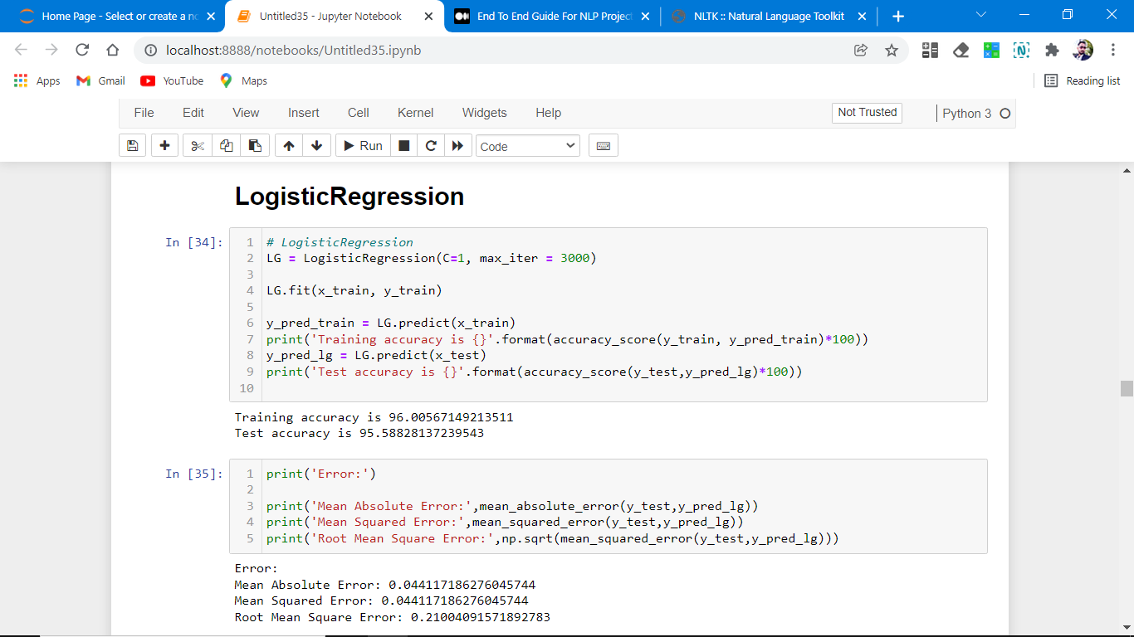
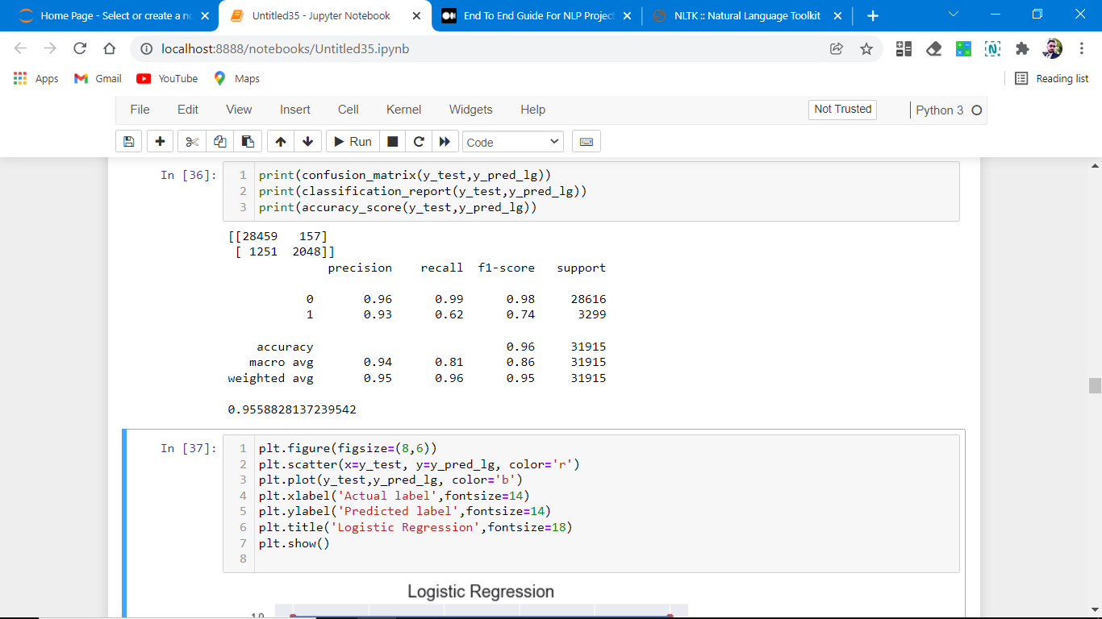
Run and Evaluate selected models
Logistic Regression Model
• Logistic Regression is a machine learning algorithm based on supervised learning.
• It performs a regression task. Regression models a target prediction value based on independent variables.
• It is mostly used for finding out the relationship between variables and forecasting.

Slide 27
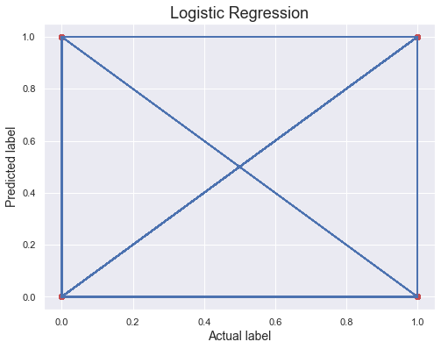
Plotting of actual label and predicted label on best fit line.
As we observe that accuracy is not 100% that’s why it comes like this.

Slide 28
Conclusion of the Logistic Regression.
Observations:
This Logistic Regression Performs with 95.55% accuracy for predicting labels.
We use the best-fit line.
from sklearn.metrics import accuracy_score,confusion_matrix,classification_report
[[28459 157]
[ 1251 2048]]
precision recall f1-score support
0 0.96 0.99 0.98 28616
1 0.93 0.62 0.74 3299
accuracy 0.96 31915
macro avg 0.94 0.81 0.86 31915
weighted avg 0.95 0.96 0.95 31915
from above we easily find out that
Precision, recall,fl-score from the above plotting.
Our model performs well on the initial level,

Slide 29
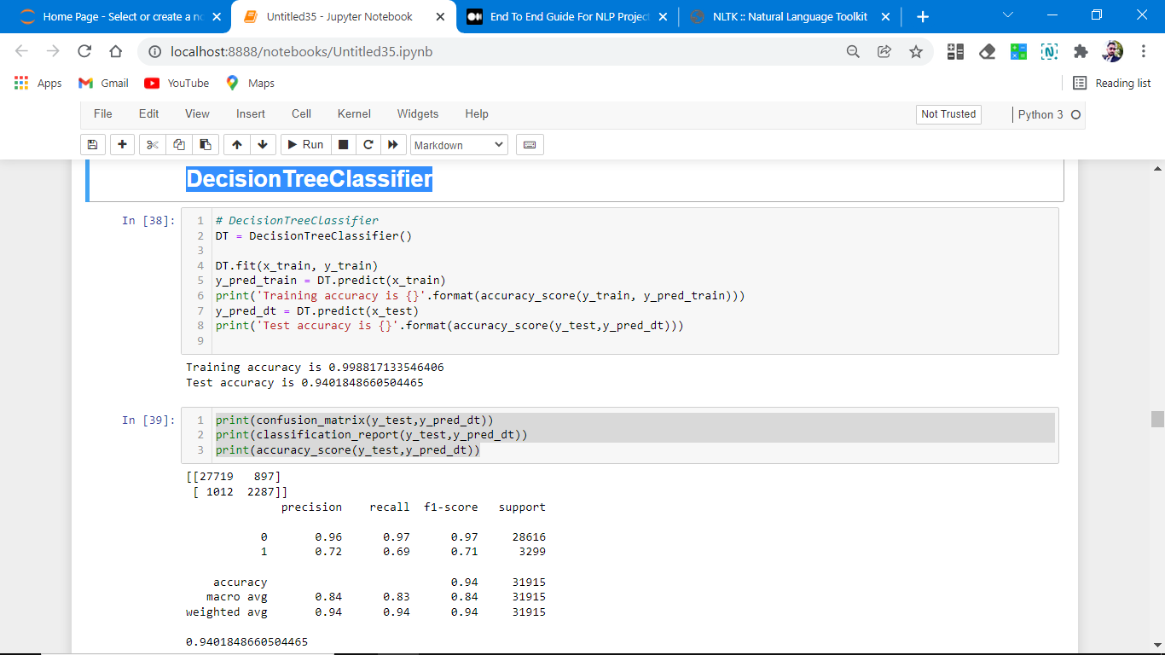
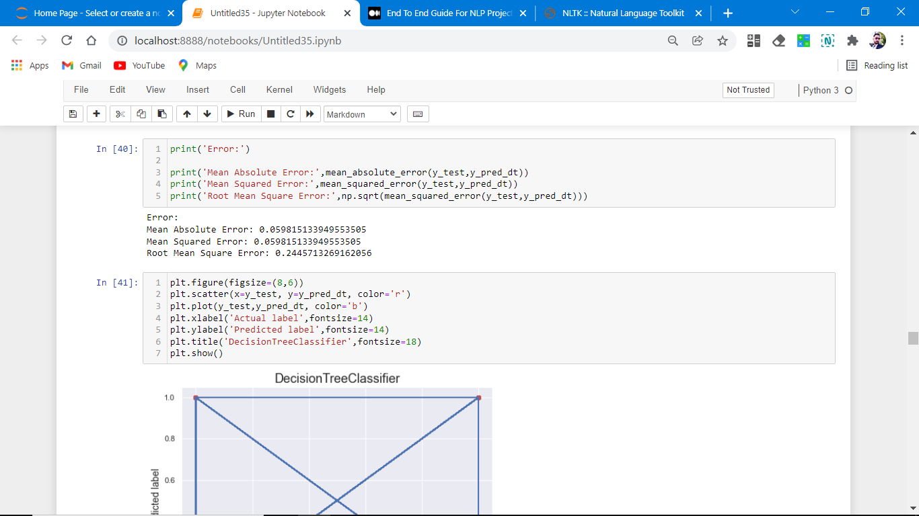
2. DecisionTreeClassifier
DecisionTreeClassifier is a class capable of performing multi-class classification on a dataset.
As with other classifiers, DecisionTreeClassifier takes as input two arrays: an array X, sparse or dense, of shape (n_samples, n_features) holding the training samples, and an array Y of integer values, shape (n_samples,), holding the class labels for the training samples:

Slide 30
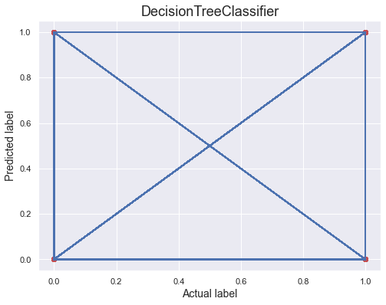
Plotting of actual label and predicted label on best fit line

Slide 31
Observations:
This Decision Tree classifier Performs with 87% accuracy for predicting frauds.
After predicting and plotting the predicted data on the best fit line we observe that DT-C is not so accurate.
CV is not well. And does not give accurate results.
print(accuracy_score(y_test,pred_decision)) print(confusion_matrix(y_test,pred_decision)) print(classification_report(y_test,pred_decision))
[[27719 897]
[ 1012 2287]]
precision recall f1-score support
0 0.96 0.97 0.97 28616
1 0.72 0.69 0.71 3299
accuracy 0.94 31915
macro avg 0.84 0.83 0.84 31915
weighted avg 0.94 0.94 0.94 31915
0.9401848660504465 accuracy score.

Slide 32
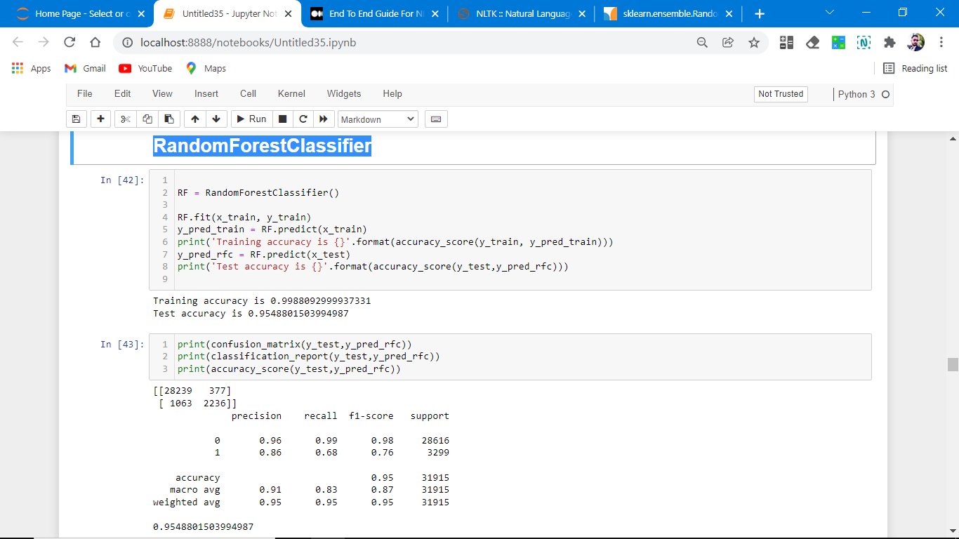
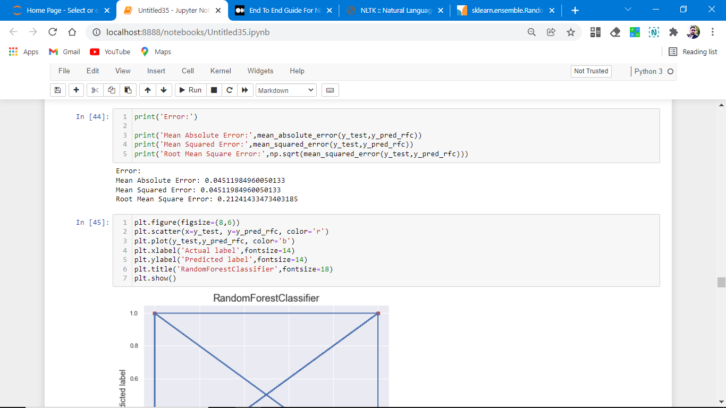
RandomForestClassifier
A random forest is a meta estimator that fits several decision tree classifiers on various sub-samples of the dataset and uses averaging to improve the predictive accuracy and control over-fitting. The sub-sample size is controlled with the max_samples parameter if bootstrap=True (default), otherwise the whole dataset is used to build each tree.

Slide 33
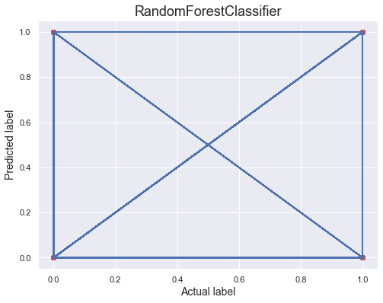
Conclusion:
[[28239 377]
[ 1063 2236]]
precision recall f1-score support
0 0.96 0.99 0.98 28616
1 0.86 0.68 0.76 3299
accuracy 0.95 31915
macro avg 0.91 0.83 0.87 31915
weighted avg 0.95 0.95 0.95 31915
0.9548801503994987 Accuracy Score
Random forest performs the same as DTC.

Slide 34
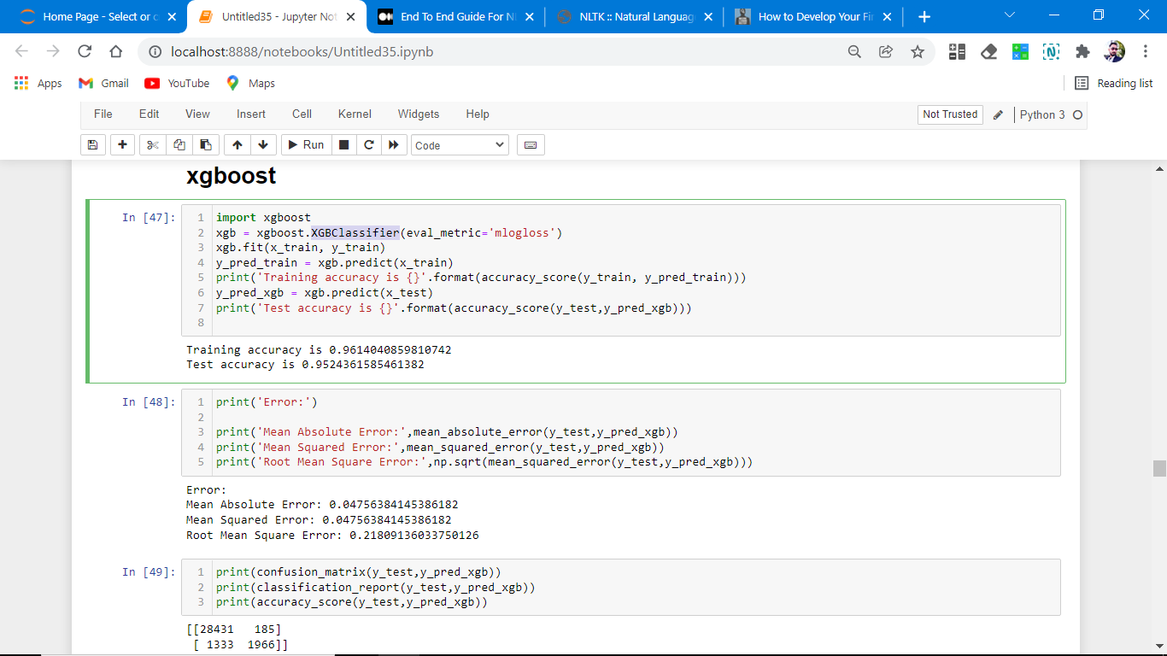
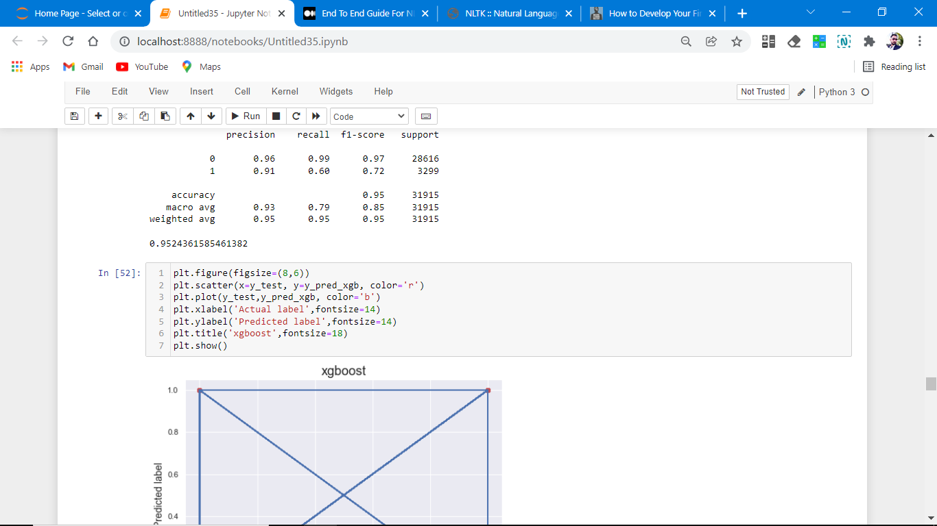
XGBoost Classifier
XGBoost provides a wrapper class to allow models to be treated like classifiers or regressor in the sci-kit-learn framework. This means we can use the full sci-kit-learn library with XGBoost models. The XGBoost model for classification is called XGBClassifier.We can create and fit it into our training dataset. Models are fit using the sci-kit-learn API and the model. fit() function. Parameters for training the model can be passed to the model in the constructor.

Slide 35
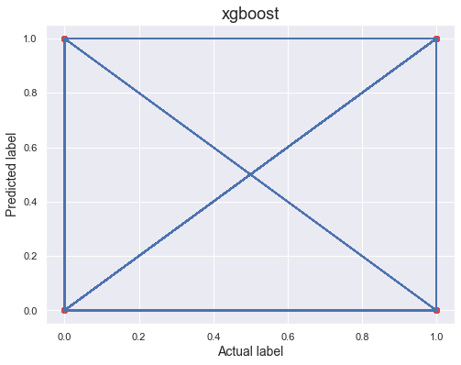
[[28431 185]
[ 1333 1966]]
precision recall f1-score support
0 0.96 0.99 0.97 28616
1 0.91 0.60 0.72 3299
accuracy 0.95 31915
macro avg 0.93 0.79 0.85 31915
weighted avg 0.95 0.95 0.95 31915
0.9524361585461382 Accuracy score

Slide 36
Key Metrics for success in solving the problem under consideration
Confusion matrix
Mean Absolute Error
Mean Squared Error
Root Mean Square Error
This matrix helps to understand the model more deeply.

Slide 37
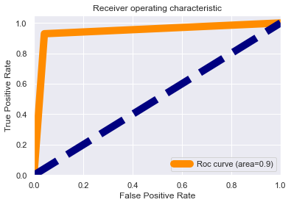
Interpretation of the Results
List of accuracy scores of different classification models
logistic Regression:- 0.9557888140372865
Decision Tree Classifier:- 0.9382422058593138
Random Forest classifier:- 0.9555694814350619
xgboost:- 0.9528434905216983
AdaBoostClassifier:- 0.949114836283879
KNeighborsClassifier:- 0.917781607394642
Observations:
1. Roc curve area is 0.9 which means that our model is distinguished between the malignant comment or not.
2. Our model understands that label 0 is 95% different than label 1, which is good.
3. It means there is a 95% chance that the model will be able to distinguish between positive class and negative class.

Slide 38
Key Findings and Conclusions of the Study
So, our Aim is achieved as we have successfully ticked all our parameters as mentioned in our Aim Column. It is seen that nltk libraries help us to find the outcomes. All the feature columns are positively co-related. Our model accuracy is over 95% which is good in terms of initial model building.
We tested out different models for training and testing on our given dataset and after all the training and testing on different models we find out that Logistic regression is performed above all.

Slide 39
Learning Outcomes of the Study in respect of Data Science
That's it! We reached the end of our exercise.
Throughout this kernel, we put into practice many of the strategies for predicting whether comments are malignant or not. We philosophized about the variables, we analyzed 'Comment _text' alone and with the most correlated variables, we tested some of the fundamental statistical assumptions and we even transformed text data into int32 type. That's a lot of work that Python helped us make easier.

Slide 40
Limitations of this work and Scope for Future Work
As we do lots of research and our data set is quite big which helps us to find different toxic words from around the world which makes this study successful still as generations are evolved and continuously discovering new slag words which make comments toxic. we don’t rely on this data for too long continuously adding more stopwords in the nltk library for helping us to make more powerful models and make us future-ready.

